Slide 1


Slide 2
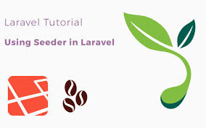
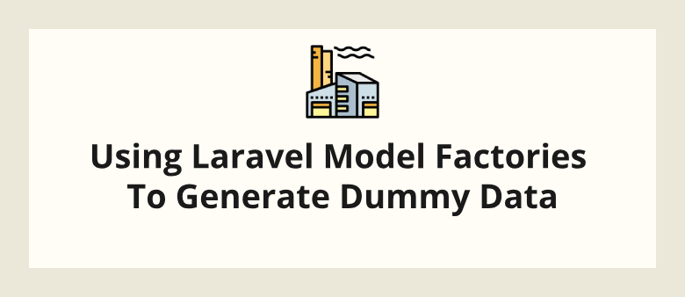
Database: Seeding Lec 8
Seed
Migration Structure

Slide 3
seed php artisan db:seed -h
Description:
Seed the database with records
Usage:
db:seed [options]
Options:
--class[=CLASS] The class name of the root seeder [default: "Databa
--database[=DATABASE] The database connection to seed
--force Force the operation to run when in production
-h, --help Display this help message
-q, --quiet Do not output any message
-V, --version Display this application version
--ansi Force ANSI output
--no-ansi Disable ANSI output
-n, --no-interaction Do not ask any interactive question
--env[=ENV] The environment the command should run under
-v|vv|vvv, --verbose Increase the verbosity of messages: 1 for normal ou

Slide 4
BaseSeeder
<?php
use Illuminate\Database\Seeder;
abstract class BaseSeeder extends Seeder
{
public function run()
{
if(!isset($this->table)){
throw new Exception("No Table Specified");
}
if(method_exists(get_class(),"getData“ )){
throw new Exception("No Data Specified");
}
DB::table($this->table)->truncate();
DB::table($this->table)->insert($this->getData());
}
}

Slide 5
BaseSeeder
<?php
class HKUTableSeeder extends BaseSeeder
{
protected $table="h_k_u_s";
public function getData(){
return [
["title"=>"Phone"],
["title"=>"Email"],
["title"=>"FB"],
["title"=>"Frindes"],
];
}
}

Slide 6
DatabaseSeeder
<?php
use Illuminate\Database\Seeder;
class DatabaseSeeder extends Seeder
{
public function run()
{
$this->call(VoluntaryDegreeTableSeeder::class);
$this->call(VoluntaryCaseTableSeeder::class);
$this->call(CommissionTableSeeder::class);
}
}

Slide 7
Running Seeders
composer dump-autoload
php .\artisan migrate --seed

